Slide 1
LLM-Driven Game
(The singularity is closer than yesterday.)
Minjae Kyung
04-19-2025
Notes:
Hello, I'm Minjae Kyung. I will now begin the presentation for the CS380 project, ‘LLM Driven Game’.

Slide 2
AI-Driven
Game
LLM-Driven Game
Overview
Project Explain
Demo
Conclusion
Notes:
The presentation will proceed in the following order. First, in the Overview, I'll explain the background for choosing this topic. Then, in the Project Explanation part, I'll talk about the considerations and the implementation process. Following that, I'll demonstrate the features of my project, and finally, in the Conclusion, I'll summarize the pros and cons of this approach and wrap up.

Slide 3
Overview
Notes:
ChatGPT, which is now familiar to us, was launched on November 30, 2022, based on GPT 3.5. It hasn't even been three years since the concept of Large Language Models, or LLMs, really started becoming widely known.

Slide 4

"Who wrote this?" "GPT wrote it"
GPT-3.5
November 30, 2022
Notes:
ChatGPT, which is now familiar to us, was launched on November 30, 2022, based on GPT 3.5. It hasn't even been three years since the concept of Large Language Models, or LLMs, really started becoming widely known.

Slide 5
"Who wrote this?" "GPT wrote it"
GPT-3.5
November 30, 2022
Million
1
Notes:
In less than those three years, the number of ChatGPT users has increased approximately 400-fold, and it has now become deeply integrated into our daily lives, becoming an indispensable companion.

Slide 6
"Who wrote this?" "GPT wrote it"
400
Million
o3
April 16, 2025
Notes:
In less than those three years, the number of ChatGPT users has increased approximately 400-fold, and it has now become deeply integrated into our daily lives, becoming an indispensable companion.

Slide 7
In LLM, take a week off and you become a newbie
16,400 | Max Input Tokens | 200,000
4,096 | Max Output Tokens | 100,000
- | AIME 2025 | 88.9%
(MMLU) 43.1% | MMLU Pro | 85.6%
GPT-3.5
o3
November 30, 2022
April 16, 2025
Notes:
LLMs have made leaps not only in user numbers but also in performance. Previously, GPT 3.5 could only process about 16,000 tokens of information at most, but the latest model, o3, can handle 200,000 tokens at once, allowing it to tackle more complex and lengthy problems. Let's take the MMLU benchmark as an example for performance comparison. MMLU was a standard test for evaluating the language understanding capabilities of many AI models, but as recent high-performance models scored higher, reducing its discriminatory power, a more difficult MMLU-Pro version emerged. For high-performance models, the score difference between MMLU and MMLU-Pro ranges from about 12 to 30 points, with the gap becoming more pronounced for higher-performing models. GPT 3.5, which was many people's first encounter with LLMs, scored 43 on the non-pro MMLU, while the latest o3 model scores 85.6 on MMLU-Pro, demonstrating tremendous performance improvement. In fact, while the older GPT 3.5 often gave inaccurate answers even to simple questions, we can feel that the latest models handle even university-level knowledge or problems without difficulty.

Slide 8
In LLM, take a week off and you become a newbie
o3
April 16, 2025
Notes:
The performance improvement of LLMs is particularly striking in the field of programming. The latest model, OpenAI's o3, achieved a score of 2727 in the Codeforces test, where programmers worldwide compete, ranking higher than 99.8% of participants. Seeing AI performance continuously advancing like this led me to think...

Slide 9
156 | ymmpersa | 81 | 2751
157 | RDDCCD | 51 | 2749
158 | green_gold_dog | 47 | 2748
159 | Tlatoani | 126 | 2747
160 | Noam527 | 144 | 2746
160 | KevinWan | 123 | 2746
160 | Wuyanru | 37 | 2746
163 | fengqiyuka | 27 | 2745
164 | CJ-zhuyifan | 34 | 2744
165 | E869120 | 36 | 2738
165 | Xylenox | 141 | 2738
165 | Chinese_zjc_ | 49 | 2738
168 | sevll777 | 210 | 2736
168 | kshitij_sodani | 121 | 2736
170 | Mangooste | 65 | 2733
170 | zhaohaikun | 71 | 2733
172 | DPprince | 12 | 2731
173 | lexiyvv | 143 | 2729
174 | Dominater069 | 70 | 2728
175 | RanRankeainie | 10 | 2727
176 | LeoPro | 115 | 2726
177 | PersistentLife | 56 | 2725
178 | dreamoon_love_AA | 375 | 2724
178 | wwwoodddd | 20 | 2724
180 | physics0523 | 226 | 2722
180 | umbrella-leaf | 36 | 2722
182 | BigBag | 278 | 2720
182 | Nutella3000-7 | 10 | 2720
184 | Nyaan | 143 | 2719
184 | Zanite | 59 | 2719
186 | namelessgugugu | 23 | 2717
187 | teraqqq | 29 | 2715
188 | sansen | 157 | 2713
GPT. You are equal to or greater than me
Codeforces
o3
Score: 2727
April 16, 2025
Notes:
The performance improvement of LLMs is particularly striking in the field of programming. The latest model, OpenAI's o3, achieved a score of 2727 in the Codeforces test, where programmers worldwide compete, ranking higher than 99.8% of participants. Seeing AI performance continuously advancing like this led me to think...

Slide 10

Then, wouldn't AI be able to handle everything in the game?
o3
April 16, 2025
Notes:
Perhaps LLMs could go beyond just handling NPC dialogue and manage the game progression itself? I wanted to explore the possibility of using LLMs, based on the transformer architecture that predicts the next word, to run an entire game.

Slide 11
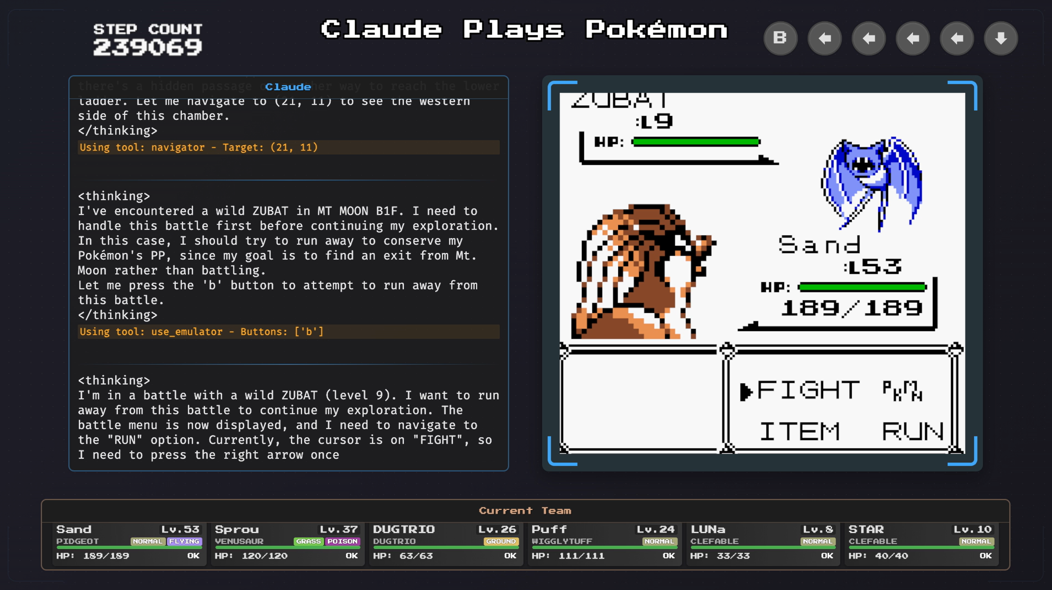
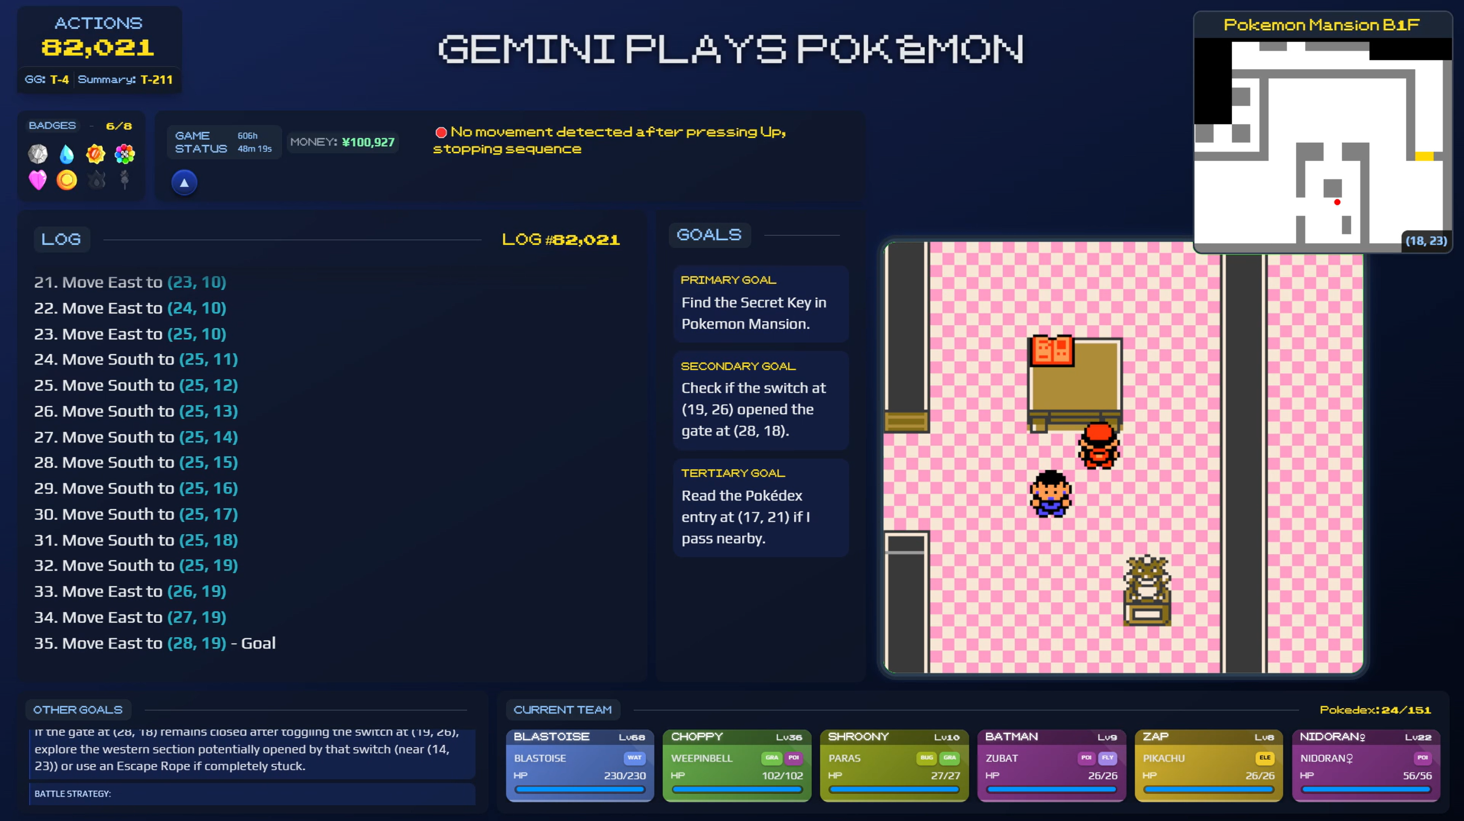

Actually, they can play the game!
ClaudePlaysPokemon
Gemini_Plays_Pokemon
Notes:
And this wasn't just a far-fetched idea. Recently, with the rise of more advanced models, AI performance has taken another significant leap forward. For example, Anthropic's Claude 3.7 Sonnet and Google's Gemini 2.5 Pro models were shown playing Pokémon games via live stream. These models demonstrated that even though they are general-purpose LLMs we use daily, not AI specialized for gameplay, they could understand the game's rules and actually play it. These examples were a crucial factor that gave me confidence in the potential success of my project.

Slide 12
Project Explain
Notes:
Okay, now I'll start explaining the project in detail. The model I used is Gemini 2.5 Pro, developed by Google. It's also one of the models used in the Pokémon playing demonstrations I mentioned earlier. The first reason I chose this model is its performance. There's a platform called 'Chatbot Arena' where users evaluate which LLM gives better answers to the same questions. Looking at the leaderboard there, the score difference between adjacent ranks is usually around 5 points. However, Gemini 2.5 Pro holds the top spot with overwhelming performance, showing a significant gap of over 30 points from the second-place model; it's a state-of-the-art model. I decided that such high performance is essential for the role of a game manager, which needs to handle complex game situations without errors, so I chose Gemini 2.5 Pro.

Slide 13

Let’s plan it
Chatbot Arena Elo Score
1439
1402
1407
DeepSeek-R1
GPT-4.5
(Preview)
Grok-3
(Preview)
ChatGPT-4o
latest
(2025-03-26)
Gemini 2.5 Pro
(Preview)
03-25
Gemini 2.5 Pro Preview 03-25
*o3 does not have score yet
Notes:
Okay, now I'll start explaining the project in detail. The model I used is Gemini 2.5 Pro, developed by Google. It's also one of the models used in the Pokémon playing demonstrations I mentioned earlier. The first reason I chose this model is its performance. There's a platform called 'Chatbot Arena' where users evaluate which LLM gives better answers to the same questions. Looking at the leaderboard there, the score difference between adjacent ranks is usually around 5 points. However, Gemini 2.5 Pro holds the top spot with overwhelming performance, showing a significant gap of over 30 points from the second-place model; it's a state-of-the-art model. I decided that such high performance is essential for the role of a game manager, which needs to handle complex game situations without errors, so I chose Gemini 2.5 Pro.

Slide 14
Let’s plan it
Context | 0 | 400 | 1k | 2k | 4k | 8k | 16k | 32k | 60k | 120k
Score | 100 | 100 | 100 | 100 | 97.2 | 91.7 | 66.7 | 86.1 | 83.3 | 90.6
Gemini 2.5 Pro Preview 03-25
Notes:
Also, LLMs generally tend to show decreased performance and memory retention as conversations get longer and the number of tokens to process increases. However, Gemini Pro is considered a model that overcomes this limitation. The chart you see now shows benchmark results measuring the model's memory retention based on the number of input tokens. Although performance dips slightly around the 16,000 token mark, it recovers afterward, maintaining a high memory retention level of around 90% even at 120,000 tokens. This is why I judged that consistent game management would be possible without performance degradation, even if the game becomes long and the amount of information to process increases.

Slide 15
Let’s plan it
2,000,000 | Max Input Tokens | 200,000
Free 1.5$ / 5$ | Price (Per 1M token) | 10$ / 40$
Good | Performance | Slightly better
Middle | Latency | Very Slow
Gemini 2.5 Pro Preview 03-25
o3
Notes:
As you listen to my presentation, you might have a question. Earlier in the Overview, I mentioned that OpenAI's o3 is a state-of-the-art high-performance model, so why did I use Gemini for the project? The biggest reason is cost-effectiveness. As you can see from this table, there's a significant difference in API usage costs. Gemini allows up to 25 free uses per day, and for paid usage, it's $1.5 per million input tokens and $5 per million output tokens. In contrast, o3 is much more expensive at $10 and $40, respectively. While o3 might be slightly ahead in terms of performance, Gemini also offers sufficiently excellent performance. Furthermore, regarding latency, which is important in games, Gemini shows fast response times relative to its excellent performance, whereas o3 is comparatively slower. Additionally, when o3 was released, the project was already significantly underway, so I didn't feel a strong need to change the model.

Slide 16
Let’s plan it
Game
Initialize
Enemy
Game Manager
Display
User
Notes:
Now, I'll explain the overall structure of the project I implemented. It's as shown in the diagram on the screen.

Slide 17
Let’s plan it
Game
Initialize
Enemy
Game Manager
Display
User
Notes:
In this structure, the LLM takes on the roles of Game Manager and Enemy. Since the Initialize step runs only once at the start of the game, you can see that the core part of the actual gameplay is proactively managed and progressed by the AI.

Slide 18
Let’s plan it
Game Manager
Notes:
Let me explain each part in more detail. First is the Game Manager AI. Personally, I don't particularly like the term 'prompt engineering,' but since Gemini's output is heavily influenced by the prompt content, I had to carefully design the system prompt. The system prompt is structured as follows: First, it clearly defines the Role the LLM must perform. Second, it provides game rules and character background settings for reference in dialogue generation. Third, it passes a list containing card stats and effects. Finally, I included various guidelines to obtain consistent and efficient results.

Slide 19
Let’s plan it
System Prompt
Game Manager
System Instruction
Game Rule
Lore
Card List
Guideline
Notes:
Let me explain each part in more detail. First is the Game Manager AI. Personally, I don't particularly like the term 'prompt engineering,' but since Gemini's output is heavily influenced by the prompt content, I had to carefully design the system prompt. The system prompt is structured as follows: First, it clearly defines the Role the LLM must perform. Second, it provides game rules and character background settings for reference in dialogue generation. Third, it passes a list containing card stats and effects. Finally, I included various guidelines to obtain consistent and efficient results.

Slide 20

Let’s plan it
System Prompt
Initialize
System Instruction
Game Rule
Lore
Game Manager
Card List
Guideline
Notes:
Randomness is very important in card games, but it's one of the aspects that LLMs struggle to handle internally. Randomness is particularly essential in the process of shuffling the deck. However, LLMs inherently find it difficult to generate random elements directly, especially when the model's Temperature value is set low for consistent performance. To address this, I used a method where the decks for the user and the enemy AI are shuffled randomly beforehand during the Initialize phase before the game starts, and then that order is passed to the Game Manager AI.

Slide 21
Let’s plan it
Game Manager
Notes:
The Game Manager comprehensively considers the user's input, the system prompt, and the current game state to generate and output the current status information for the user and the enemy. This status information includes each player's health, cards in hand, available mana, and context-appropriate character dialogue.

Slide 22
Let’s plan it
Status
Game Manager
Game Info
Health
Is valid / Error state
Field Cards
Hand Cards
User Status
Deck Cards
Enemy Status
Dialogue
Notes:
The Game Manager comprehensively considers the user's input, the system prompt, and the current game state to generate and output the current status information for the user and the enemy. This status information includes each player's health, cards in hand, available mana, and context-appropriate character dialogue.

Slide 23
Let’s plan it
Enemy Input
User Input
Game Info
User Input
Game Info
Notes:
Additionally, careful attention was needed in designing the input data format between the Enemy LLM and the Game Manager LLM. LLMs typically operate by accumulating previous conversation history and using it as the next input. However, this often assumes a single user-single LLM interaction. In a structure like this project, where one user interacts with two LLMs (Game Manager, Enemy), the input format had to be carefully constructed. The method I used is as follows: First, the user's input and the Game Manager's output are bundled together and passed as input to the Enemy AI. Then, based on this information, the Enemy AI assesses the current situation and the value of its cards in hand to select and use the card with the highest utility value. This can be seen as a form of utility-based AI design.

Slide 24
Let’s plan it
Enemy Input
Enemy
Enemy Output
User Input
Game Info
…
User Input
Game Info
Notes:
Additionally, careful attention was needed in designing the input data format between the Enemy LLM and the Game Manager LLM. LLMs typically operate by accumulating previous conversation history and using it as the next input. However, this often assumes a single user-single LLM interaction. In a structure like this project, where one user interacts with two LLMs (Game Manager, Enemy), the input format had to be carefully constructed. The method I used is as follows: First, the user's input and the Game Manager's output are bundled together and passed as input to the Enemy AI. Then, based on this information, the Enemy AI assesses the current situation and the value of its cards in hand to select and use the card with the highest utility value. This can be seen as a form of utility-based AI design.

Slide 25
Let’s plan it
Enemy Input
Enemy Output
Enemy
User Input
Game Info
…
User Input
Game Info
Notes:
Additionally, careful attention was needed in designing the input data format between the Enemy LLM and the Game Manager LLM. LLMs typically operate by accumulating previous conversation history and using it as the next input. However, this often assumes a single user-single LLM interaction. In a structure like this project, where one user interacts with two LLMs (Game Manager, Enemy), the input format had to be carefully constructed. The method I used is as follows: First, the user's input and the Game Manager's output are bundled together and passed as input to the Enemy AI. Then, based on this information, the Enemy AI assesses the current situation and the value of its cards in hand to select and use the card with the highest utility value. This can be seen as a form of utility-based AI design.

Slide 26
Let’s plan it
Game Manager
User Input
Game Info
Game Info
…
User Input
Game Info
Enemy Output
Notes:
And the action chosen by the Enemy AI (like playing a card) is then passed back to the Game Manager, formatted with the 'User' role, as if the user had made the input. This allowed for the implementation of a natural game flow where the user, Enemy AI, and Game Manager interact sequentially, taking turns, and I confirmed that this method works effectively.

Slide 27
Let’s plan it
Game Manager
Game Info
User Input
Game Info
User Input
…
Game Info
Enemy Output
Notes:
And the action chosen by the Enemy AI (like playing a card) is then passed back to the Game Manager, formatted with the 'User' role, as if the user had made the input. This allowed for the implementation of a natural game flow where the user, Enemy AI, and Game Manager interact sequentially, taking turns, and I confirmed that this method works effectively.

Slide 28
Let’s plan it
Game Manager
Game Info
User Input
Game Info
User Input
…
Game Info
Enemy Input (user)
Notes:
And the action chosen by the Enemy AI (like playing a card) is then passed back to the Game Manager, formatted with the 'User' role, as if the user had made the input. This allowed for the implementation of a natural game flow where the user, Enemy AI, and Game Manager interact sequentially, taking turns, and I confirmed that this method works effectively.

Slide 29
Demo Time!
Notes:
Now, I’ll show you demo

Slide 30
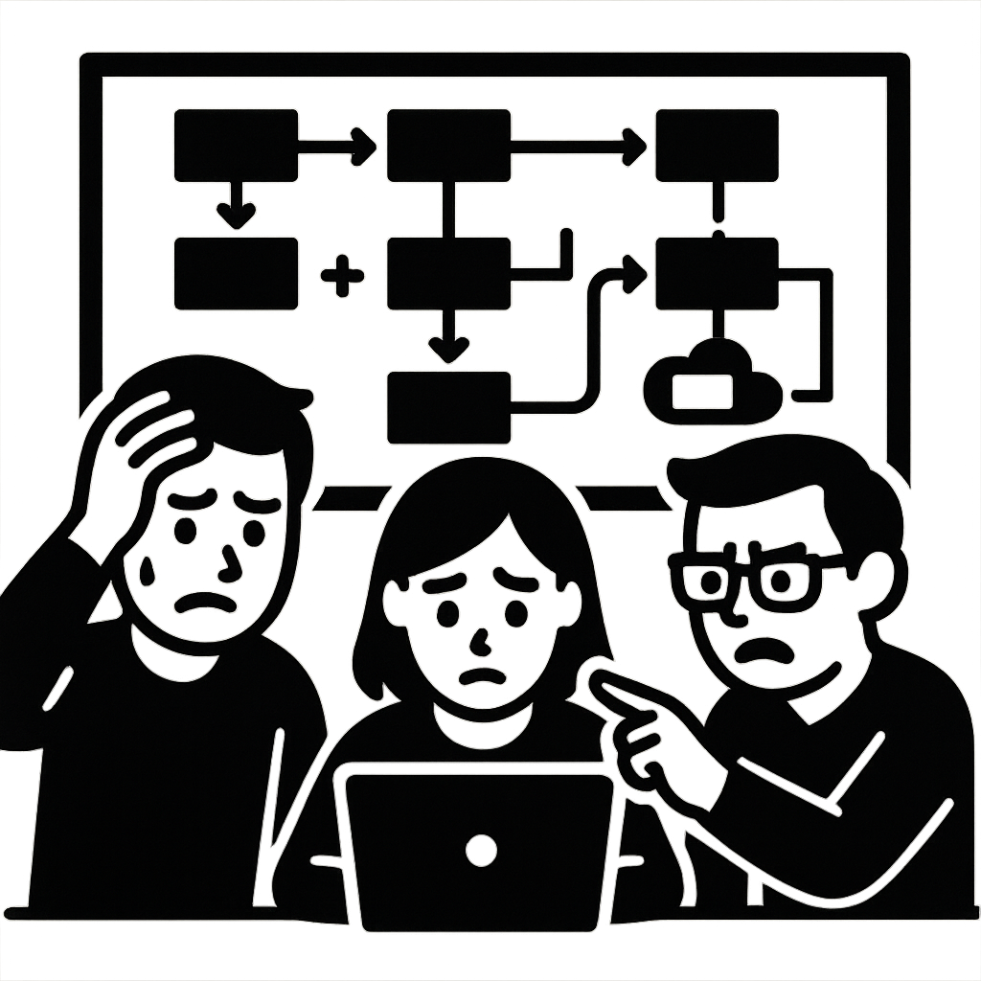

We can see some hope!
Notes:
As you saw in the demo, the game utilizing the LLM works relatively well. In a short development period of about a week, I was able to implement the core logic of a card game with various effects all by myself. Simply defining the game rules and card effects and passing them to the LLM was enough to enable game progression. This confirms the high efficiency of game development using LLMs.

Slide 31

We can see some hope!
Notes:
Developing games this way also offers advantages in terms of maintenance. When adding new features, expansion is possible simply by adding a description of the feature to the LLM's system prompt, without the burden of worrying about conflicts with existing code or complex logic modifications. Therefore, updating and maintaining the game becomes very easy.

Slide 32

We can see some hope!
Notes:
Another advantage of LLMs is the ability to create flexible and dynamic elements. As seen in the demo, it can generate natural dialogue in real-time tailored to various situations, such as when an NPC is attacked by a specific card or finds itself in a disadvantageous position, offering players a higher level of immersion.

Slide 33

We can see many nah…
Notes:
However, there are also some clear limitations at the current technological level. First is the long latency. While card games aren't a genre where real-time responsiveness is extremely critical, the waiting time for the AI's response was noticeably long. Particularly during the enemy's turn, the processing times for both the Enemy AI and the Game Manager AI added up, resulting in significant waiting periods.

Slide 34

We can see many nah…
Notes:
Second is the lack of stability. As could occasionally be seen even during the demo, LLM-based progression still lacks stability compared to directly programmed logic. For example, errors sometimes occurred, such as the Game Manager failing to correctly distribute cards or mana at the start of a new turn, or the Enemy AI repeating its immediately preceding action. This is a problem that critically impacts the game experience and shows that, currently, there are limitations to reliably running an entire game solely with LLMs.

Slide 35

How to improvement
Gemini 2.5 Flesh Preview 04-17
Notes:
Through this project, I confirmed the potential of LLM-based game development, as well as its current limitations—that is, the need for further improvement. However, further attempts can be made in the following directions. The first is to reduce latency by using lightweight models. Of course, the performance of current lightweight models might be somewhat insufficient for handling complex game logic. However, lightweight models are emerging, like the recently released lightweight version of Gemini Pro, Gemini 2.5 Flash, which achieve performance close to OpenAI's flagship model, GPT-4o. Considering this rapid pace of technological advancement, I expect that soon, even lightweight models will be capable enough to perform game management.

Slide 36


How to improvement
Notes:
The second direction for improvement is utilizing AI for generating game visuals (Display). Recently, technologies have emerged that can rapidly generate images in very few steps, making near real-time image generation possible. If this is utilized, just as the LLM generates context-appropriate dialogue, an image generation AI could instantly create visual elements fitting the game situation, further enriching the visual presentation.

Slide 37
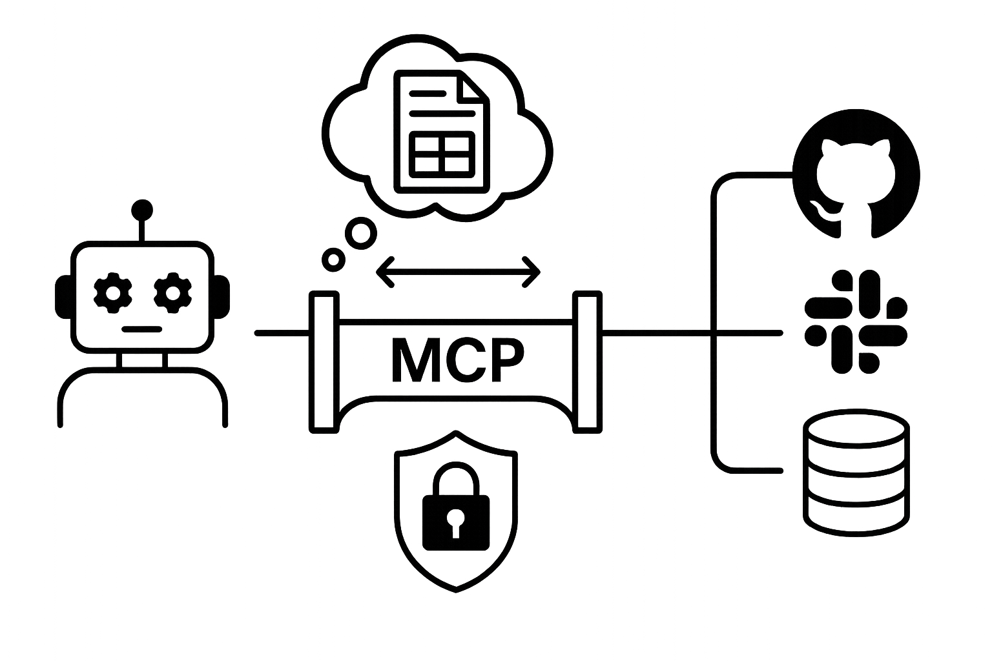
How to improvement
Notes:
Finally, implementing in-game randomness more completely by utilizing external communication methods like the MCP protocol. The current project pre-shuffles the card deck randomly at the start and passes it, but there's a limitation in that if random elements are involved in card special abilities during gameplay, it's difficult for the LLM to handle them directly. To compensate for this, if the AI is implemented to request and receive random values from an external system via methods like the MCP protocol when randomness is needed, it would be possible to handle the various random elements occurring within the game more accurately.

Slide 38
Thank you!
Notes:
It was my presentation. Thank you.

